Slide 1

Code Mastery: Creating Reactive Applications With SignalR Jason Bock Practice Lead
August 1, 2017
Notes:
If your system doesn’t have the CORDIA NEW font, please use “Title Slide (Alt)”

Slide 2
Personal Info
http://www.magenic.com
http://www.jasonbock.net
https://www.twitter.com/jasonbock
https://www.github.com/jasonbock
jasonb@magenic.com

Slide 3
Downloads
https://github.com/JasonBock/ReactiveSignalR

Slide 4
Overview
Reactive
SignalR
Demos
Remember….
https://github.com/JasonBock/ReactiveSignalR

Slide 5
Reactive
???
Notes:
What is reactive programming?

Slide 6

Reactive
http://wallpapercave.com/wp/3nvhFN9.jpg
Notes:
Think about our universe. Everything is essentially a reaction to an action

Slide 7



Reactive
http://www.redorbit.com/media/uploads/2013/03/ChemicalReactions_031513-617x416.jpg
http://icyroadsafety.com/parts/blackice1.jpg
http://i5.asn.im/couple-arguing-_ucgr.jpg
Notes:
Lots of events that happen in our lives are based on what happens around us and what we do with that information.

Slide 8
Reactive
Responsive
Elastic
Resilient
Message Driven
http://www.reactivemanifesto.org/
Notes:
The reactive manifesto defines 4 characteristics of reactive systems:
Responsive - Responsive systems focus on providing rapid end consistent response times, establishing reliable upper bounds so they deliver a consistent quality of service
Resilient - The system stays responsive in the face of failure. This applies not only to highly-available, mission critical systems — any system that is not resilient will be unresponsive after a failure. Resilience is achieved by replication, containment, isolation and delegation
Elastic - Reactive Systems can react to changes in the input rate by increasing or decreasing the resources allocated to service these inputs
Message Driven - Reactive Systems rely on asynchronous message-passing to establish a boundary between components that ensures loose coupling, isolation and location transparency

Slide 9
Reactive
Client
Server
Invokes
Notes:
How do we typically do communications between clients and servers? Easy, the client makes a call to the server. This is usually done with REST these days, but it can happen in other ways. The point is, the client initializes the call, and will either “wait” for a response (typically asynchronous), or fire and forget.

Slide 10
Reactive
Client
Server
Invokes
Notes:
But what if we reverse the arrow? Maybe we want our service to notify the client when specific actions have occurred even though the client didn’t initialize the request.

Slide 11
Reactive
What is the current stock
price for MSFT?
StocksDB
68.36 (5/12/2017, 6:43 PM Central)
Notes:
Let’s talk about stock tickers. We can ask for the price of a stock at a particular point in time.

Slide 12
Reactive
What is the current stock
price for MSFT?
StocksDB
Notes:
Doing this over and over can work, but we can miss changes, and this may unnecessarily cause network resource usage

Slide 13
Reactive
Tell me when the stock
price changes for MSFT
StocksDB
68.32
68.34
Notes:
Instead, let’s react to the changes in price.

Slide 14

Reactive
https://upload.wikimedia.org/wikipedia/commons/e/ea/NY_stock_exchange_traders_floor_LC-U9-10548-6.jpg
Notes:
Side note: keep in mind, stock trading is not like what this picture shows. That’s very old school!

Slide 15
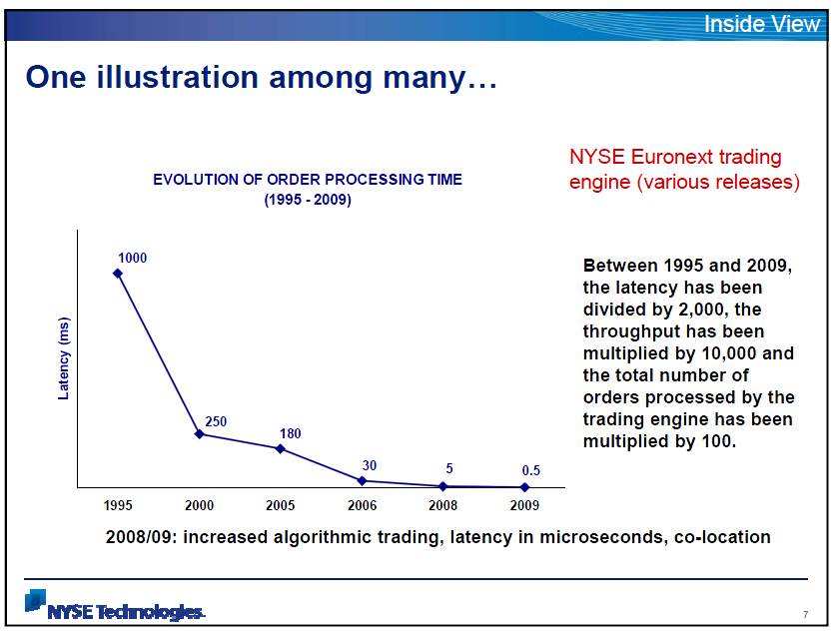
Reactive
https://publicintelligence.net/wp-content/uploads/2010/05/nysespeeds.png
Notes:
The volume and speed has increased dramatically.

Slide 16
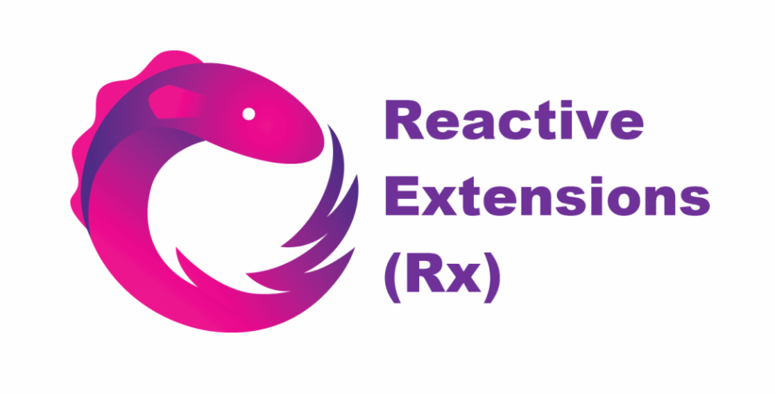
Reactive
http://reactivex.io/
Notes:
Reactive Extensions (or ReactiveX) is an API that makes reactive programming easy (or at least easier).

Slide 17
Reactive
Java
JavaScript
C#
Scala
Clojure
C++
Lua
Ruby
Python
Go
Groovy
Kotlin
Swift
PHP
Elixir
Dart
http://reactivex.io/languages.html
Notes:
There’s a lot of implementations of Reactive Extensions, but we’ll be focusing on C#/.NET.

Slide 18
Reactive
In .NET 4.0
IObserver<T>
OnCompleted()
OnError(Exception e)
OnNext(T value)
IObservable<T>
Subscribe(IObserver<T> observer)
Notes:
Rx is based on two key interfaces

Slide 19
Reactive
1
4
2
5
8
3
Notes:
What’s so awesome about Rx is that it makes async streams composable. That is, you can write code to handle these streams just like you would with collections

Slide 20
Reactive
1
4
2
5
8
3
.Where(x => x % 2 == 0)
4
2
8
Notes:
Let’s say I only cared about even numbers. I could use a Where() clause….

Slide 21
Reactive
1
4
2
5
8
3
.Take(3)
1
4
2
Notes:
Or I only wanted the first three values. Take()

Slide 22
Reactive
1
4
2
5
8
3
.Delay(TimeSpan.FromSeconds(2))
1
4
2
5
8
3
2 seconds
Notes:
Or I wanted to delay the production of these values. Delay()

Slide 23
Reactive
2.5 seconds
1
4
2
5
8
3
.Throttle(TimeSpan.FromSeconds(2))
X
Notes:
Or I want to know when something hasn’t happened in a while. Throttle()

Slide 24
Demo: Using Rx for Key Logging
Creating Reactive Applications With SignalR
Notes:
Let’s log some keys and see how we can handle that with Rx.

Slide 25

SignalR
http://orig04.deviantart.net/4edb/f/2010/263/4/e/world_wide_web_by_devrez-d2z5zq5.png
Notes:
Now that you know how to handle reactive data, let’s see how we can do this on the internet. The internet is a great source of reactive data.

Slide 26
SignalR
Chat
Comments
Orders
Gaming
Weather
Application Flow
Key Watching ☺
Notes:
Here’s a number of examples where you could use notifications. And if you’re evil, you can use a keylogger to listen to messages!

Slide 27
SignalR
WebSocket is designed to be implemented in web browsers and web servers, but it can be used by any client or server application. The WebSocket Protocol is an independent TCP-based protocol. Its only relationship to HTTP is that its handshake is interpreted by HTTP servers as an Upgrade request. The WebSocket protocol enables interaction between a browser and a web server with lower overheads, facilitating real-time data transfer from and to the server. This is made possible by providing a standardized way for the server to send content to the browser without being solicited by the client, and allowing for messages to be passed back and forth while keeping the connection open. In this way, a two-way (bi-directional) ongoing conversation can take place between a browser and the server. The communications are done over TCP port number 80 (or 443 in the case of TLS-encrypted connections), which is of benefit for those environments which block non-web Internet connections using a firewall. Similar two-way browser-server communications have been achieved in non-standardized ways using stopgap technologies such as Comet.
https://en.wikipedia.org/wiki/WebSocket

Slide 28
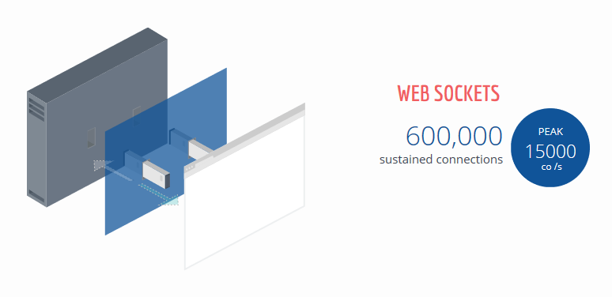
SignalR
http://stackexchange.com/performance
Notes:
By the way, if you think this isn’t a “performant” way to write applications, keep in mind that StackExchange does 600,000 sustained connections, 15,000 per second

Slide 29
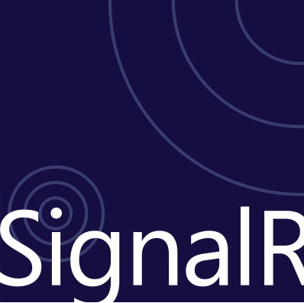
SignalR
https://visualstudiomagazine.com/articles/2013/06/26/~/media/ECG/visualstudiomagazine/Images/introimages/012213BuildaSignalRApp.ashx
Notes:
So, how do you pull this communication off? SignalR is a good choice to do this in .NET and web applications. You can host SignalR wherever you want, and push messages to clients that are listening. Note, you can use WebSockets in .NET directly if you’d like: https://msdn.microsoft.com/en-us/library/system.net.websockets(v=vs.110).aspx.

Slide 30
SignalR
WebSockets
Server-Sent Events or EventSource
Forever Frame
Ajax long polling
Notes:
SignalR employs a number of fallback strategies to do notifications – keep in mind WebSockets is the preferred choice.

Slide 31
SignalR
Hub
Connection
Notes:
SignalR also has two main ways to communication to clients: connections and hubs.

Slide 32
SignalR
Behavior | Code
All connected clients | Clients.All
Only calling client | Clients.Caller
All clients except the caller | Clients.Others
Specific client | Clients.Client(Context.ConnectionId)
All clients except specific ones | Clients.AllExcept(connectionId1, …)
Specific group | Clients.Group(groupName)
Notes:
You can also specify which clients should receive messages. Here’s a handful of scenarios SignalR supports. Note the “Group” option. You can specify groups that only certain users can be a part of.

Slide 33
Demo: Broadcasting Keys With SignalR
Creating Reactive Applications With SignalR
Notes:
Let’s expand our demo to log a group of keys, send them to a server, and broadcast bad words for all the world to see

Slide 34
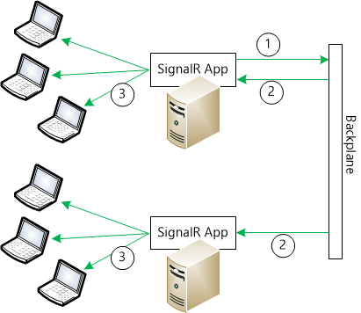
SignalR
https://docs.microsoft.com/en-us/aspnet/signalr/overview/performance/scaleout-in-signalr
Notes:
If you have multiple servers/instances of SignalR running, you’ll need to add a backplane so the messages get distributed across all instances. There’s default implementations for SQL Server and Redis out of the box if you need it. You can also create your own if you want to be ambitious ☺

Slide 35
SignalR
Binary data support, e.g. send/receive binary data
Host-agnostic (enables non-HTTP transports)
New Endpoints API
Presence feature
Multiple protocols/formats support, e.g. JSON, ProtoBuf, custom
Support “pure” WebSocket clients
New clients (TypeScript, C#, C++, Java, Swift)
Flexible scale-out extensibility
No jQuery dependency!
https://speakerdeck.com/davidfowl/introducing-asp-dot-net-core-sockets
https://github.com/aspnet/signalr
https://channel9.msdn.com/Events/Build/2017/B8078
Notes:
Here’s a peek at the future for SignalR

Slide 36


Conclusion
+
=
Notes:
Rx + SignalR = LOVE!

Slide 37
Code Mastery: Creating Reactive Applications With SignalR Jason Bock Practice Lead
August 1, 2017
Remember…
https://github.com/JasonBock/ReactiveSignalR
References in the notes on this slide
Notes:
Rx:
The Reactive Manifesto - http://www.reactivemanifesto.org/
ReactiveX - http://reactivex.io/
Introduction to Rx - http://www.introtorx.com/
Master time with Reactive Extensions - http://haacked.com/archive/2014/03/10/master-time-with-reactive-extensions/
SignalR:
Introduction to Scaleout in SignalR - https://docs.microsoft.com/en-us/aspnet/signalr/overview/performance/scaleout-in-signalr
Introduction to SignalR - https://docs.microsoft.com/en-us/aspnet/signalr/overview/getting-started/introduction-to-signalr
SignalR Documentation - https://docs.microsoft.com/en-us/aspnet/signalr/
SignalR .NET Core: Realtime cross-platform open web communication - https://channel9.msdn.com/Events/Build/2017/B8078
Asynchronous scalable web applications with real-time persistent long-running connections with SignalR - https://www.hanselman.com/blog/AsynchronousScalableWebApplicationsWithRealtimePersistentLongrunningConnectionsWithSignalR.aspx
SignalR - https://channel9.msdn.com/Events/dotnetConf/2014/SignalR
SignalR Transports Explained - http://kevgriffin.com/signalr-transports-explained/
Enable SignalR Logging with One Simple Line - http://kevgriffin.com/signalr-logging/
Tutorial: SignalR Self-Host - https://docs.microsoft.com/en-us/aspnet/signalr/overview/deployment/tutorial-signalr-self-host
Use OWIN to Self-Host ASP.NET Web API 2 - https://docs.microsoft.com/en-us/aspnet/web-api/overview/hosting-aspnet-web-api/use-owin-to-self-host-web-api

